Slide 1
Introduction to High-Level BDAT-Based Roadmap
Transition Planning - Developing a clear roadmap of change to existing operations and systems
Transition planning requires a roadmap of change that represents the discreet tactical demands that involve the development of new business capabilities or at simply the uplift of existing ones.
Demands are contextualized in terms of their expected impact:
  Business– development of knowledge and skills, changes to the organizational structure, cultural programs, etc.
  Data – changes to data governance, data quality and data management practices, data model re-design, etc.
  Application – new/update application development, feature enhancement of existing applications and/or interfaces
  Technology – new platform development, consolidation of redundant systems, feature enhancement of existing systems
Demands are grouped into Initiatives
Planning considerations:
  Prioritization of demands (strategically important capabilities should be undertaken sooner).
  Dependencies between demands help guide sequencing and timing.
  Horizon timings depend on the scale and duration of change plans.

Slide 2
Business Demand 3
Later
Business Demand 2
Business
Business Demand 1
Application Demand 3
Data Demand 3
Next
Data Demand 2
Data Demand 1
Application Demand 2
Data
Now
Application Demand 1
Pallet
Demands
Dependencies
Application
Business Demand
Data Demand
Application Demand
Technology Demand 1
Technology Demand
Initiatives are represented by color
Technology

Slide 3
Business Demand 3
Later
Business Demand 2
Business
Business Demand 1
Id | Demand
BD1 | Business Demand 1
BD2
BD3
DD1 | Data Demand 1
DD2
DD3
AD1 | Application Demand 1
AD2
AD3
TD1 | Technology Demand 1
Application Demand 3
Data Demand 3
Next
Data Demand 2
Data Demand 1
Application Demand 2
Data
Now
Application Demand 1
Pallet
Demands
Dependencies
Application
Business Demand
Data Demand
Application Demand
Technology Demand 1
Technology Demand
Initiatives are represented by color
Technology

Slide 4
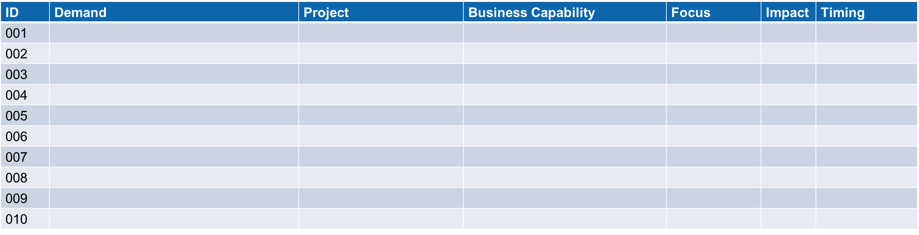
Introduction to Mapping Initiatives to Capabilities
1. Business Capability
Identifying the business capability each initiative supports provides valuable context as to its strategic importance.
5. Demand
Identify the business capability each initiative supports provides valuable context as to its strategic importance.
2. Focus
Business, Data, Application, Technology
4. Timing
Months
3. Impact
Uplift, New, Retire

Slide 5
Mapping Initiatives to Capabilities
ID | Demand | Project | Business Capability | Focus | Impact | Timing
001
002
003
004
005
006
007
008
009
010

